Slide 1
***DISCLAIMER***
This link is only for the access of the Christian County Waste Water Class presentation.
The following slide will provide you with the instructions to install within the County.

Slide 2
***Instructions***
Installers
Home Owners
Must come to the office building at 301 E. Brick St, Ozark, during normal business hours Mon-Fr 8:00-12:00 & 1:00-4:30. Excluding holidays.
Provide your State onsite wastewater license or a copy of it for our records.
Pay the $50 license fee for Christian County
Fill out the provided informational sheet
Take the provided test with a passing score
Allow the department a 15 business day period to grade your test and mail a license
Must come to the office building at 301 E. Brick St, Ozark, during normal business hours. Mon-Fr 8:00-12:00 & 1:00-4:30. Excluding holidays.
Fill out the provided informational sheet
Take the provided test with a passing score
Allow the department a 15 business day period to grade your test and contact you for the confirmation.
Taking the test as a homeowner allows you apply for a septic permit for your property address alone. You will not be permitted to install anywhere else within the county. Proof of ownership will be required.
Please review the following presentation with the regulations of installing in Christian County. Click the audio icons for the voice over presentation.

Slide 3


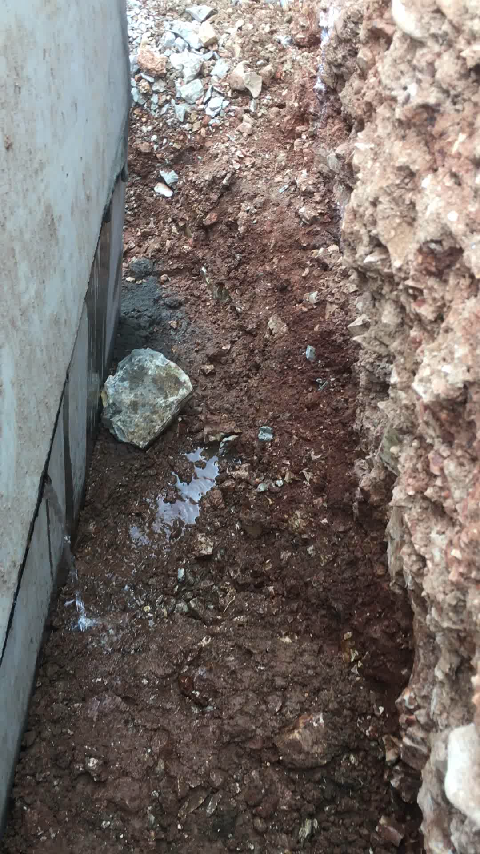

Conventional Onsite Wastewater Treatment Systems Certification Course for Installers
Updated 12/13/2022

Slide 4
Course Objectives
Obtain the basic knowledge on how to install a conventional on site wastewater treatment system in accordance with the Christian County Ordinance 043-1992 Revised 2015
Learn how to obtain a permit for the construction of an onsite wastewater treatment system from the Christian County Health Department (CCHD) and understand the inspection process of the system
Be familiar with the penalties associated violations of the Christian County onsite wastewater standards
The link to our Christian County standards for wastewater handbook: https://www.christiancountyhealth.com/_files/ugd/9bd019_ece51b3259af45be96c71a0d819ef559.pdf
Notes:
2

Slide 5
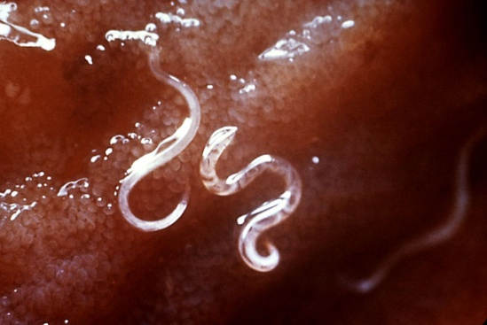

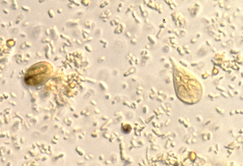
Purpose of the Ordinance
Improper treatment and disposal of sewage is an environmental public health concern
Has the potential to spread disease through contaminated groundwater
Contaminated groundwater can spread disease through private drinking water supplies (i.e., wells)
      Salmonella enterica
      Clostridium perfringens
      Escherichia coli
      Hepatitis-causing viruses
      Hookworm-causing nematodes
Nematodes
Bacteria
Protozoa
Notes:
2

Slide 6
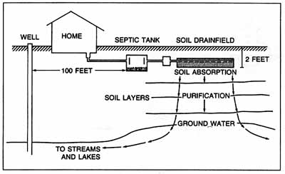
Waste Water Recycling

Slide 7
DEPARTMENT OF NATURAL RESOURCES (DNR)
JURISDICTIONDHSS? or DNR?
Approval of the use of Onsite Systems for Subdivisions and Residential Housing Units
( ≥ 7 new or ≥ 3 additional units) - CO Commercial/Industrial Facilities
Generating ‘Non-domestic’ Wastewater Determined by DNR - RO or CO
NPDES Discharge Permits - RO
Land Application of
Septage & Wastewater - RO
Subsurface Surface
Single Family
Residential Lagoons
Multi-Family &
Commercial Lagoons - RO
‘Domestic’ Waste from Single and Multi-Family Residential and from Commercial Facilities
Multi-Family Residential and
Commercial ‘Domestic’ Waste - RO
DEPARTMENT OF HEALTH AND SENIOR SERVICES (DHSS) and Local Administrative Authorities
Based on DHSS Rule: ≤ 3,000 Gallons per Day > 3,000 Gallons per Day
Notes:
One diagram of Missouri’s wastewater authority. Note DHSS and LPHA authority is limited to single family lagoons, and subsurface (soil treatment) systems receiving 3,000 gpd or less of domestic waste. Examples of non-domestic wastewater: meat processing, wineries, cheese making, truck/automobile service garages with floor drains, veterinary clinics, surgery suites, kennels, fish bait operations, ethanol production facilities, etc.
If there is any question about jurisdiction, contact the Onsite Wastewater Treatment Program or Charles Harwood with DNR.

Slide 8
Design and Construction Standards
(A) Definitions, pages 18-22
(B) Standards are applicable to systems producing flows of three thousand (3,000) gallons per day (gpd) or less.
Systems with larger than 3,000 gpd flow rates are under the jurisdiction of the Department of Natural Resources. In addition, more than one residence on a single lagoon must go through the Dept. of Natural Resources (DNR).
(D) Minimum setback distances
Notes:
2

Slide 9
Purpose of the Ordinance
THEREFORE: The Christian County onsite wastewater treatment systems standards were designed to help lower the probability of environmental contamination by improper treatment and disposal of sewage from onsite wastewater treatment systems
AND: Constructing a system in accordance with these standards has the potential to minimize the spread of disease associated with sewage-contaminated water
EPA onsite manual: http://www.epa.gov/septic
Notes:
2

Slide 10
Christian County Onsite Wastewater Standards
2.1 (pg. 6)
Anyone person engaged in the construction or renovation of a onsite wastewater treatment shall obtain a construction permit from the Christian County Health Department
Permitting and inspection process:
  1. Obtain a soil evaluation by a registered soil scientist
  2. Select a licensed installer (state and county)
  3. Submit fully completed application form
  4. Review by CCHD Environmental Public Health Specialist (EPHS) and pre-site evaluation
  5. Final inspection of fully constructed system by CCHD EPHS
  6. Approval/Disapproval by CCHD EPHS
  7. Modifications to system if any, final paperwork delivered to installer
Notes:
2

Slide 11
3.3 pg 7 – Applicants shall guarantee workmanship and materials on all installations of onsite wastewater treatment systems for one year (your guarantee is your signature on the application)
3.7 – keep your records for at least 3 years
5.2 – must provide at least 24 hours notice for final inspection

Slide 12
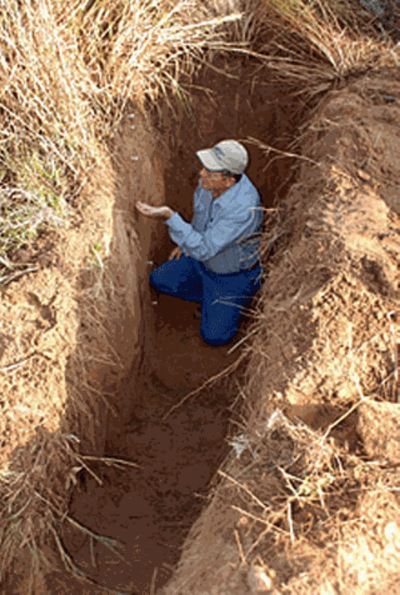

Christian County Onsite Wastewater Standards
Obtain a soil evaluation by a registered soil scientist
  A list of registered soil scientists and contact information are available at CCHD
The soil scientist performs a soil morphology evaluation
  Only performing a percolation tests is not accepted as a valid soil evaluation in Christian County
A minimum of one soil pit of a depth of a minimum of 48 inches is required to determine significant soil characteristics
Notes:
2

Slide 13
Christian County Onsite Wastewater Standards
Obtain a soil evaluation by a registered soil scientist
  A list of registered soil scientists and contact information are available at CCHD
The soil morphology report includes information such as:
1. Topography and landscape position.
2. Soil Morphology
3. Soil drainage
4. Restrictive soil horizons
5. Soil Depth.
6. Available space
Notes:
2

Slide 14
Christian County Onsite Wastewater Standards
Obtain a soil evaluation by a registered soil scientist
Each of the six factors will be given a limitation rating by the soil scientist (slight, moderate, severe) and the overall limitation rating of the site is based on the most limiting factor.
Based on the soil morphology report, the soil scientist will recommend the optimal area to install the onsite wastewater treatment system.
The soil scientist specifies a “represented area” and gives the rep. area a loading rate in gpd/ft² (a number that specifies how well the soil can absorb.)
Notes:
2

Slide 15
Christian County Onsite Wastewater Standards
After submission of the three required items: (1) soil morphology report, (2) permit application, and (3) sketch plan, a CCHD EPHS will conduct a pre-site evaluation within five (5) working days of date of submission
The site should be flagged, labeled (laterals, tank, pump, etc.), and or staked/painted and should match what the sketched plan depicts
Notes:
2

Slide 16
Christian County Onsite Wastewater Standards
SECTION X: Fee schedule (page 16)
Fees are as follows:
On-site systems
Residential (new & rehabs) $75.00
Commercial (flows greater than 240 gpd) $100.00
Commercial (flows less than 240 gpd) $75.00
Gray water system $50.00
Renewals: (Permits are good for 1 year)
Unexpired permit $5.00
Expired permit $75.00
Unnecessary trip charge $20.00
Transfer Fee $25.00
Tank Leak Test (includes initial & follow up) $40.00
Collection wastewater systems
Construction permit $200.00
Inspection/sampling $35.00 per trip/test
Building Sewer Hook-up $25.00
Installer Training Fee $50.00
Temporary License Fee $25.00
Notes:
2

Slide 17
Notes:
Don’t copy this page, need to use carbon copy forms, page 50 tho
Your signature is required for acceptance of permit application
Installer can sign for property owner

Slide 18
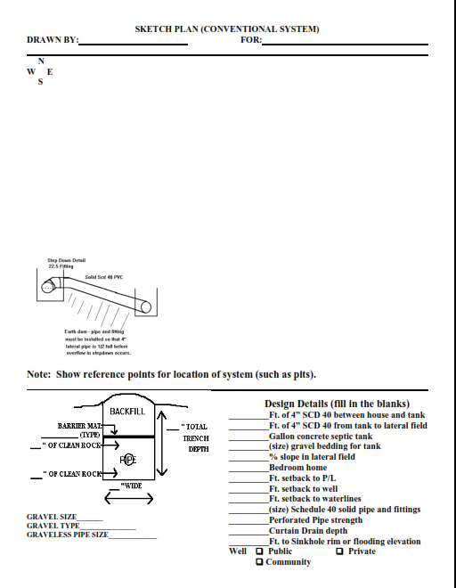

Slide 19
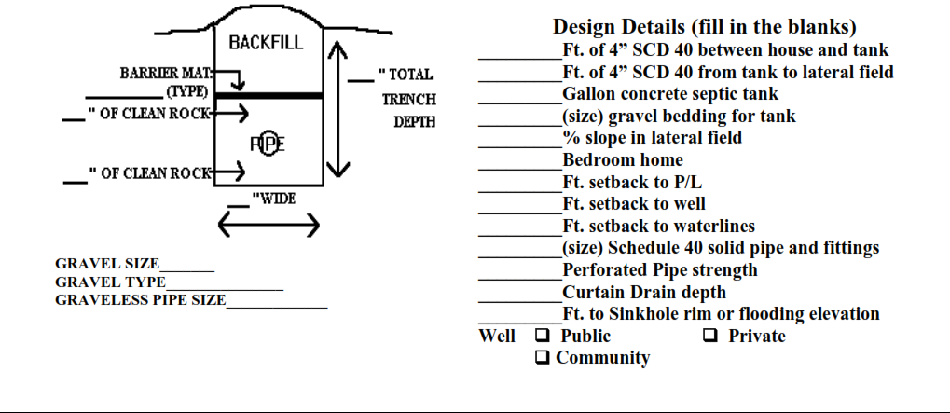

Slide 20
Christian County Onsite Wastewater Standards
The pre-site evaluation involves:
  Confirming the sketch plan has all pertinent information about the proposed system
  Checking the flags to confirm the proposed system is accurately depicted on the sketch
  All required setbacks are met
  The system is within the represented area on the soil morphology report
  No apparent geological formations in close proximity to proposed system that would increase groundwater contamination potential not mentioned on the sketch plan
  Calculations were performed correctly (flow rates, LPP worksheets, linear feet of laterals required, commercial systems, septic tank size)
  GPS location of test pits and lateral field
Notes:
2

Slide 21
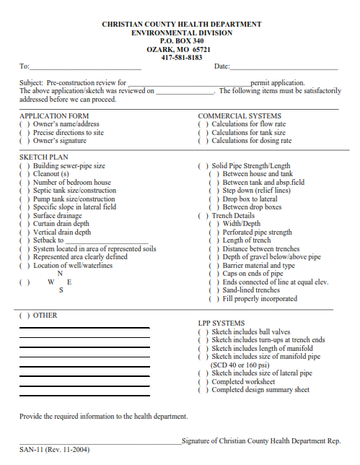

Slide 22
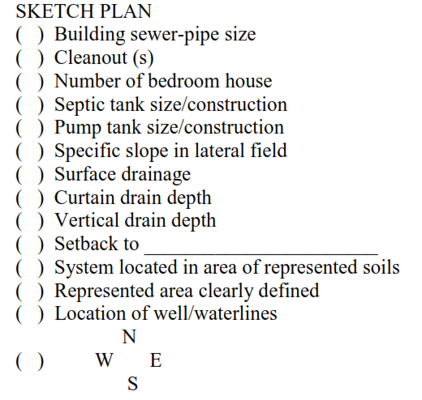
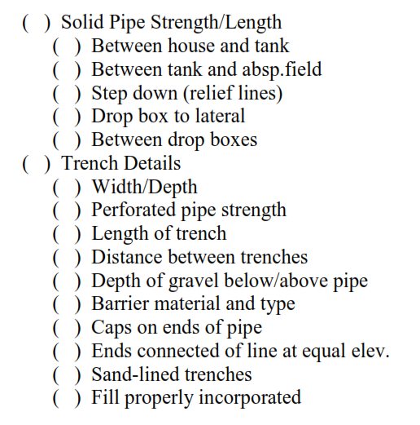

Slide 23
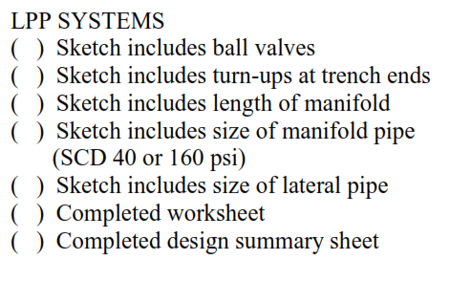
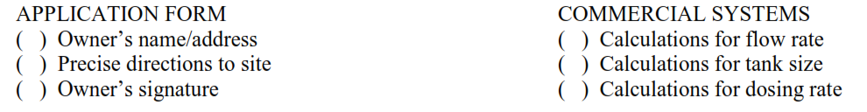

Slide 24
Christian County Onsite Wastewater Standards
After the CCHD EPHS has approved the pre-site evaluation, the installer will be contacted and given a permit number (CCHD also gives the permit number to P & Z – will need septic permit before building permit)
If after the pre-site evaluation, the EPHS does not approve the pre-site evaluation, the installer will be notified regarding what changes need to made in order to comply with Christian County standards; a second pre-site evaluation may be needed
Once a permit number has been issued, the installer will receive a text with the new permit number, and the construction of the onsite wastewater treatment system may begin and must be installed in the manner in which it was approved on the permit application. Reminder: Permits are valid for one (1) year. You must keep track of your permit expiration dates.
Notes:
2

Slide 25
Christian County Onsite Wastewater Standards
If it is discovered that changes need to be made to the system during construction, it is best to notify the CCHD inspector.
Minor changes do not necessarily need prior approval from the EPHS, however there is no guarantee that these changes will be approved upon final inspection.
Permit numbers may be transferred between licensed installers, however a transfer application needs to be submitted along with a transfer fee ($25) and the application will be processed in the same manner as described above.
Notes:
2

Slide 26
Design and Construction Standards
(D) Setback requirements
If the setback requirements cannot be met for a replacement system, a written application may be submitted for a setback variance (form on page 54).
No variances will be granted for new construction, existing only.
A variance request shall contain the following (page 24):
  A explicit description explaining why setback cannot be met
  Potential impact on adjacent property owners, and names and mailing addresses of there property owners
  Property owners will be notified by CCHD and will be allowed thirty (30) days to express any comments/concerns they may have if a variance is granted
Notes:
2

Slide 27
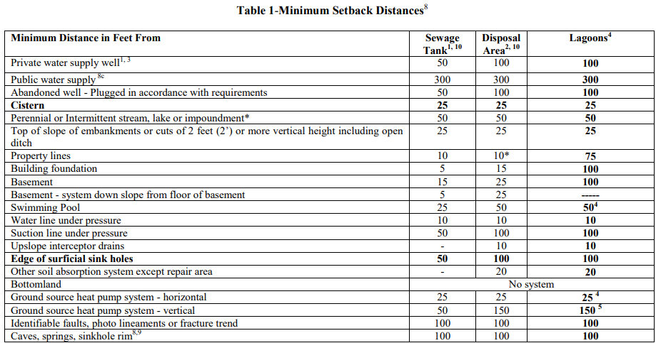
Page 23
Notes:
2

Slide 28
The design, size, and location of a septic system are dependent on the characteristics of the site.
These include topography, soil conditions, geology, and drainage. As the properties are identified, decisions regarding the design and construction can be made.
Notes:
24

Slide 29
This topographic profile shows the basic types of landforms. Areas of depression and floodplains must be avoided since these areas may become saturated and be unable to adequately treat the effluent flow.
Notes:
26

Slide 30
When locating the absorption field on the site, areas where water naturally converges (note blue flow lines) should be avoided. Areas where flow will diverge (note red flow lines) are preferable.
Notes:
27

Slide 31
A "useable area" of soil absorption should be located in an area of diverging flow. This area can be triangular, or trapezoidal in shape, but is most commonly rectangular. The larger the available area, the easier the system layout will be.
The absorption trenches should be placed perpendicular to the slope. Another
way of saying this is that the trenches will be parallel to the contour lines.
Notes:
29

Slide 32
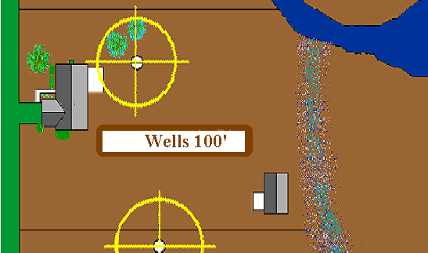
Christian County ordinance requires that the drain field be located one hundred feet from any private wells. Don't forget your neighbor's well and three hundred feet from a public well.
Notes:
32

Slide 33
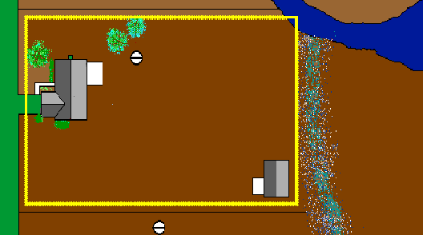
Drain fields cannot be closer than ten feet to property lines in Christian County.
Notes:
33

Slide 34
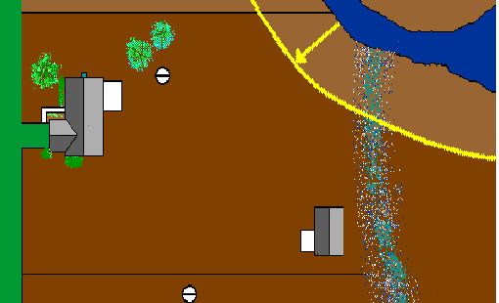
And must be located more than fifty feet from any lake or body of surface water.
Notes:
34

Slide 35
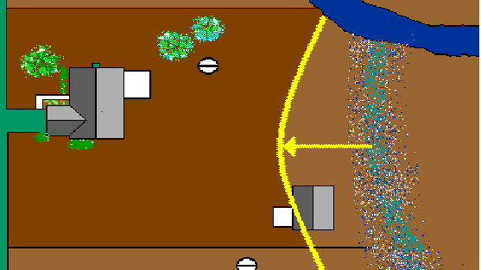
Drain fields may not be closer than twenty-five feet to any drainage ditches, and cannot be closer than one hundred feet to a sinkhole rim.
Notes:
35

Slide 36
After accounting for all of these separation distances, you can determine the useable area remaining.
Notes:
36

Slide 37
Before allowing construction to proceed, be sure that the soil is relatively dry. If the soil is too wet, construction will damage soil structure. This could cause the septic system to fail or function poorly.
Notes:
37

Slide 38
A good test for determining if the soil is too wet to excavate is to take a small amount and try to form a ribbon of soils in your hand. If the soil holds the ribbon when you open your hand, it is too wet to allow construction to proceed.
Notes:
38

Slide 39
If the soil crumbles and will not stay formed when you open your hand, then it is probably safe to allow construction to proceed.
Notes:
39

Slide 40
Design and Construction Standards
Number of Bedrooms | Minimum liquid capacity (gallons)
1 – 3 | 1000
4 | 1250
5 | 1500
(4) Sewage Tanks (page 30)
For residential units that have six (6) or more bedrooms septic tank size shall be calculated according to this formula:
V = 1.5Q + 500
Q = daily flow rate
V = liquid capacity of tank
If a grease trap is required for a food service establishment the grease trap shall be sized to provide for at least 5 gallons/meal served per day and at least 2/3 of the septic tank.
All tanks must be placed on 4”
depth gravel that is no more than 3/4” in diameter
Minimum size tank serving two residences shall be 1500 gal
Minimum size tank for any installation is 1000 gal
For tanks in a series – the larger ones get placed before the smaller ones. No more than 3 can be in series.
Notes:
2

Slide 41
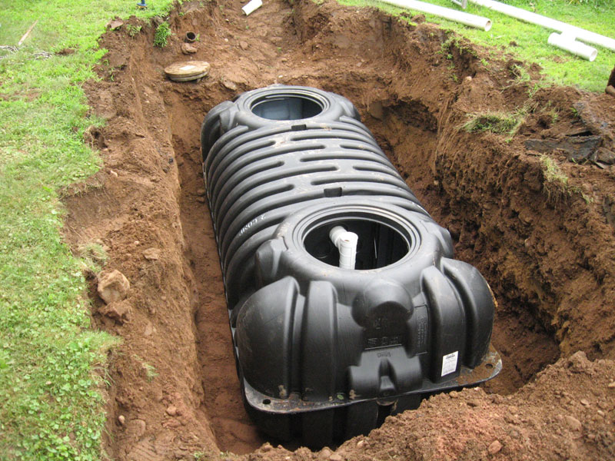
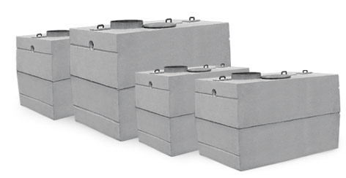
Design and Construction Standards
(4) Sewage Tanks (page 28)
Be constructed so that the tank can withstand all lateral earth pressures under saturated soil conditions when tank is empty
Be constructed to withstand 2’ of saturated earth cover above the top
Not be subject to corrosion or decay
All tanks laid on a 4” gravel bed (no greater than 3/4” dia.)
No less than 36” liquid depth**
Inlet not less than 3” above the outlet**
Notes:
2

Slide 42
Stewart Tanks
Mid Seam
 | Width | Length | Depth | Inlet | Outlet | Distance inlet - outlet | Meet Distance | Liquid depth | Meet liquid depth
1000 Gal | 80" | 92" | 53" | 44" | 41" | 3" | yes | 41" | Yes
1250 Gal | 80" | 92" | 64" | 54" | 52" | 2" | no | 52" | Yes
Top Seam
500 Gal | 96" | 48" | 43" | 32" | 31" | 1" | no | 31" | No
1000 Gal | 102" | 67" | 60" | 50" | 47" | 3" | yes | 47" | Yes
1000 Low Profile | 126" | 70" | 48" | 36”" | 39" | 3” | Yes | 36" | Yes
1250 low | 126" | 70" | 56" | 47" | 45" | 2" | no | 45" | Yes
1500 Gal | 146" | 67" | 60" | 50" | 47" | 3" | yes | 47" | Yes
1500 Gal 2 comp | 146" | 67" | 60" | 50" | 47" | 3" | yes | 47" | Yes
2000 Gal | 150" | 84" | 65" | 50" | 48" | 2" | no | 48" | Yes

Slide 43
SI Precast Concrete
Actual Tank Dimensions | Width | Length | Depth | Inlet | Outlet | Distance inlet/outlet | Meet Distance | Liquid Depth | Meet Liquid Depth
500gal | 49" | 96" | 46" | 33" | 31" | 2" | Yes | 31" | No
1000 Dual | 67” | 96” | 60” | 49.5 | 46.5 | 3” | Yes | 46.5 | Yes
1000Gal Single | 67" | 98" | 60" | 49 1/2" | 46 1/2" | 3" | Yes | 46 1/2 | Yes
1250 Gal | 67" | 117" | 60" | 49 1/2" | 46 1/2" | 3" | Yes | 46 1/2 | Yes
1500 Gal | 67" | 146" | 60" | 49 1/2" | 46 1/2" | 3" | Yes | 46 1/2 | Yes
2000 Gal | 81" | 156" | 65" | 55" | 52" | 3" | Yes | 52" | Yes
1250 Gal Aeration | 66" | 112" | 72" | 63" | 60" | 3" | Yes | 60" | Yes

Slide 44
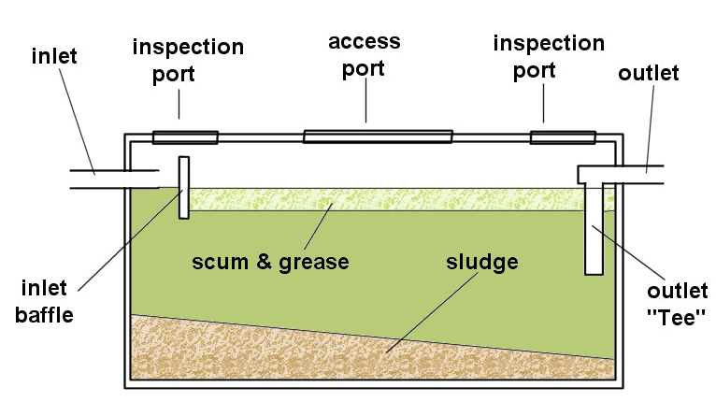
Design and Construction Standards
Baffles/Sanitary tees
  Inlet baffle shall extend at least 6” but no more than 20% of the total liquid depth
  Outlet baffle and between compartments shall extend 40% of the liquid depth
Notes:
2

Slide 45
Design and Construction Standards
Pipes going into and out of sewage tanks shall be schedule 40, cast iron or equivalent and extend a minimum of five feet (5’) beyond the outlet of the tank providing that no more than 2’ of pipe extends beyond the excavation hole (page 28)
More than 2’ across hole needs gravel bed (1½” – 3” dia.) down to hole bottom to support pipe (page 28)
C/O
2’ earth dam
≤ 2’
≤ 2
From building
To drain field or pump chamber
≥ 5’
≥ 5’
Slope 1% = 1/8” per foot
Notes:
2

Slide 46
Check for Leaks

Slide 47
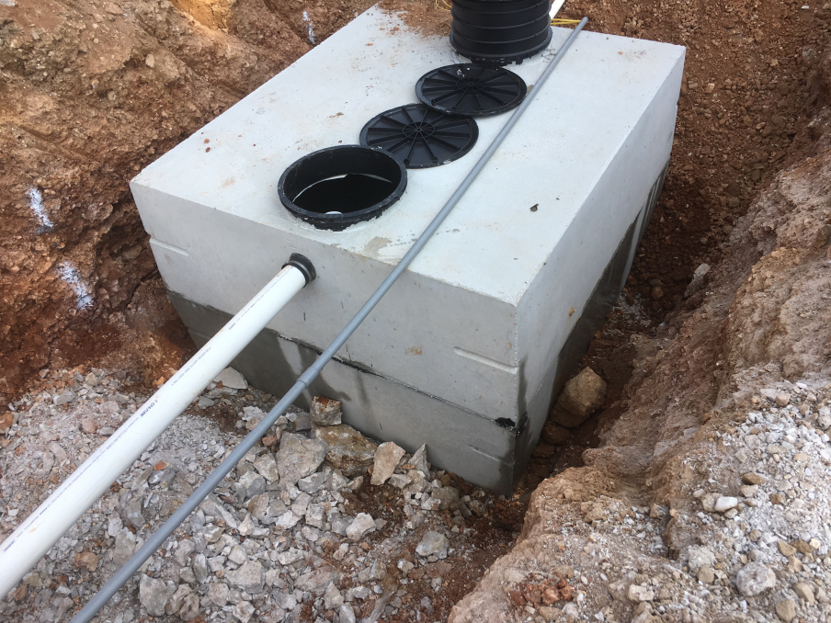
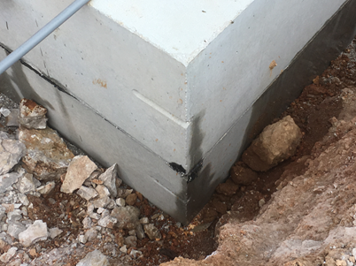
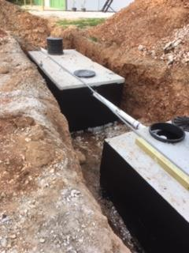

Slide 48
Design and Construction Standards
Septic tank filters can prevent solids from clogging the absorption field and are recommended, but must follow certain regulations detailed on (page 30). Filters do not eliminate the need for pumping of the septic tank.
(F) Pump tanks
  All pump tanks must be preceded with a septic tank filter
  Pump tanks for pumping to a higher elevation (not for dosing) shall be equivalent to the greater of 500 gallons or one days flow
  Pump tanks for dosing must include emergency storage for 2 times the daily flow
  Must include a visible and audible high-water alarm clearly identified as “wastewater system alarm”
Notes:
2

Slide 49
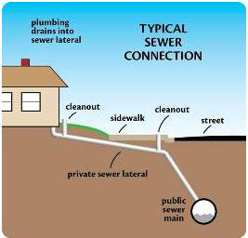
Design and Construction Standards
(3) Building sewers, pipe between tanks, & pipe between tank and drainfield (page 27)
The building sewer can be no less than 4” in diameter, preferably of schedule 40 PVC pipe
Minimum SLOPE for building to sewer:
12”/100 ft (1%) for 4” dia. pipe or
8”/100 ft (0.7%) for 6” dia. Pipe
Cleanouts provided every 100 ft and at every change of direction or slope if the change exceeds 45° or more (page 28)
Notes:
2

Slide 50
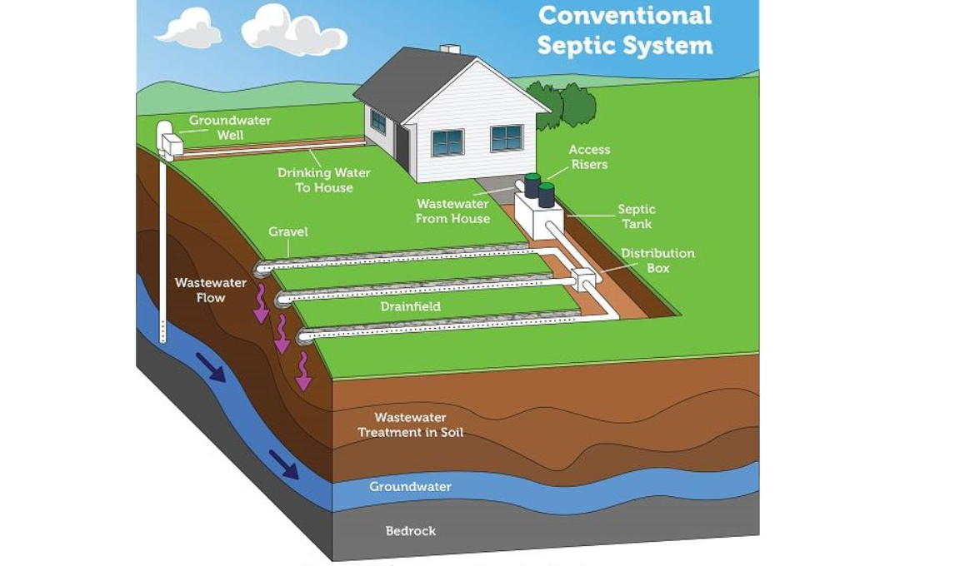
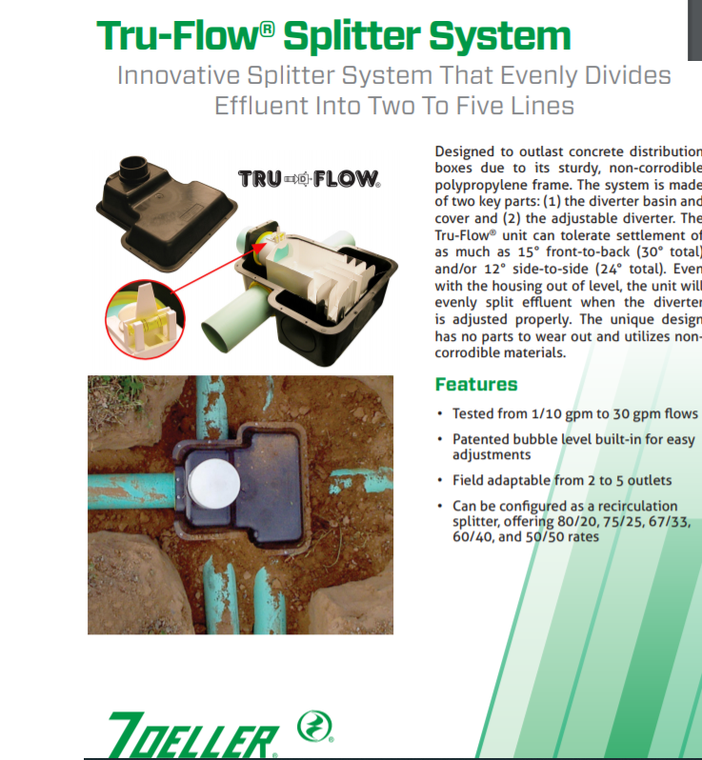
Distribution Boxes

Slide 51
Distribution Boxes
Distribution boxes shall be separated from tank by at least 2 feet of compacted or undisturbed soil
Be placed level and on a solid foundation to prevent settling
Each line shall connect individually to the distribution device
Each line shall laid with letters or numbers up for easy viewing
Must remain uncovered until after trenches are backfilled
Shall be of sound construction and water tight, and not subject to corrosion

Slide 52
Design and Construction Standards
(5) Absorption Systems (page 35 )
Distribution boxes for equal (parallel) distribution-Only dipper type or engineered flow diversion boxes may be used. Engineered flow diversion boxes shall be limited to sites that do not have the necessary slope to utilize the dipper distribution box.
A filter and maintenance contract should be in place for dipper type and engineered flow diversion boxes with up to four (4) distribution lines. Dipper type or engineered flow diversion boxes with greater than four (4) but not more than six (6) distribution lines shall have a filter installed and maintenance contract in place.
Notes:
2

Slide 53
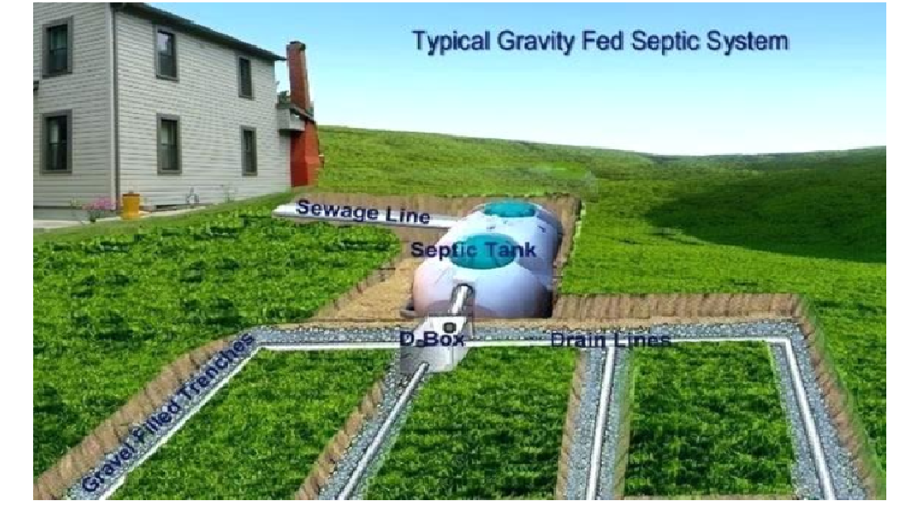
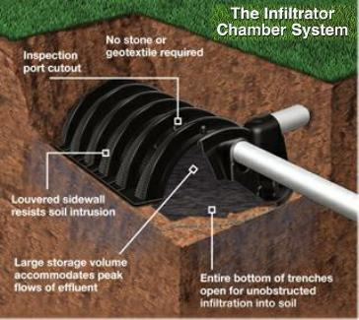
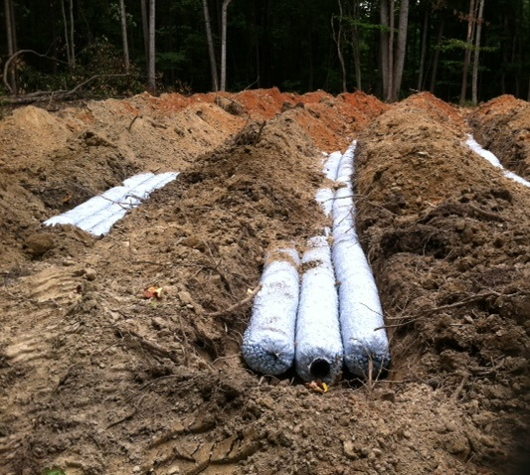
Trenches

Slide 54
Design and Construction Standards
(5) Absorption Systems (page 33-34)
Trenches cannot be constructed in severely compacted soils.
Soils that are moist enough to be smeared, shall not be worked in, unless surfaces are manually scratched to recover structure.
Soils that have been excavated cannot be used for absorption trenches unless a soil scientist documents that it will not interfere with treatment of effluent, trenches cannot be constructed in disturbed soils.
For disturbed soil to be utilized, the site evaluator shall state the soil has stabilized and has less than 27% clay content.
Trenches cannot be backfilled with soils that are frozen or saturated.
Soils with high rock fragment content greater than 50% but no greater than 70% should utilize sand-lined trenches.
Soils with rock fragment content greater than 70% shall use a LPP system with sand lined trenches or other approved system.
Minimum size for an absorption field is 600 ft²
Each absorption field system shall have 2 trenches, and no trench can exceed 100’.
Notes:
2

Slide 55
Design and Construction Standards
(5) Absorption Systems (page 33)
Standard absorption trenches cannot be constructed in soils with a loading rate of lower than 0.2 gpd/ft²
Trenches shall be designed to maximize the vertical separation from the bottom of the trench to the limiting layer or seasonal water table
  Vertical separation shall be no less than 1’ – for conventional standard systems
Lateral
≥ 1’
Limiting layer / Water table
Notes:
2

Slide 56
Design and Construction Standards
(5) Absorption Systems (page 34)
4” diameter perforation pipe with ½” diameter holes shall be used
  The diameter of the pipe needs to be at least 4” and the diameter of the holes cannot be larger that ¾”
Must meet ATSM Standard D-2729 minimum 2500 lb crushproof
Perforation pipe with three rows of holes cannot be used
Lay all pipe with the letters/numbers up so it is visible for inspection
Coiled tubing shall not be used for absorption field systems or curtain drains
Notes:
2

Slide 57
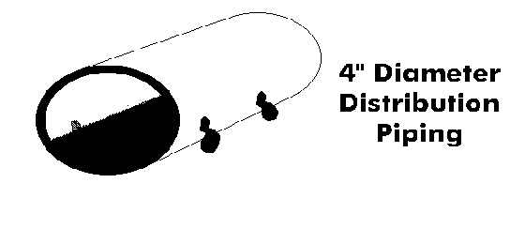
The absorption field consists of several lateral pipes that allow the effluent to slowly flow out through holes positioned along the length of the pipe. Considerable care must be taken to place the pipe level, so it will distribute liquid uniformly over the absorption area.

Slide 58
Design and Construction Standards
(5) Absorption Systems (page 34)
For inspection, every absorption trenches shall be left open and uncovered to the barrier material
Leave at least 3 areas per 100 ft in each trench that are open all the way to the trench bottom (no gravel)
  For inspection, the trenches will be measured using a calibrated level from the bottom of the trench, if gravel is present it will not be indicative of the trench bottom
Trenches shall be dug as level as possible and may not fall more than ¼” per 10 ft or 2.5” per 100ft
  All caps on ends of pipe shall be exposed for inspection
Ends shall be capped or plugged.
For “level” or “bed” systems, all lines must be connected.
Notes:
2

Slide 59
Design and Construction Standards
(5) Absorption Systems
Trench spacing is 3 times the trench width on centers with a minimum of 6’ on centers
3’
≥ 6’
≥ 9’
Notes:
2

Slide 60
Design and Construction Standards
(5) Absorption Systems (page 34)
For Trenches requiring modification due to a limiting layer or a seasonal high water table, the minimum trench spacing should be increased to 15’
  Should be addressed on the soil evaluation form by the soil scientist
Minimum trench width: 18”
Maximum trench width 36”
In no case shall an absorption system be no greater than thirty 30” (deep) below finished grade
Notes:
2

Slide 61

Design and Construction Standards
(5) Absorption Systems (page 34-35)
Rock used in trenches shall be clean, washed gravel or crushed stone (creek) 1” – 2 ½” diameter with no more than 10% material able to pass through a ½“” screen
Limestone and dolomite or other crushed rock shall be avoided when possible
  If used, it shall be between 1 ½” – 3” diameter
At least 1’ depth of rock
≥ 2”
4”
≥ 6”
Notes:
2

Slide 62
Design and Construction Standards
(5) Absorption Systems (page 35)
Before backfilling with soil, the gravel must be covered with a barrier material
  Un-backed, rolled, 3 ½” fiberglass insulation
  Untreated building paper
  Synthetic drainage fabric
  Minimum of 8” of straw for a compacted thickness of 2”
Absorption fields on a greater than 20% slope shall utilize a curtain drain
Slopes greater than 30% shall not be used for the construction of absorption fields
Notes:
2

Slide 63
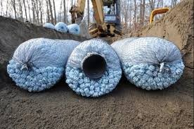
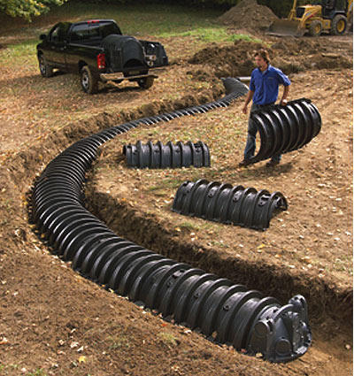
Design and Construction Standards
(5) Absorption Systems (page 36)
EZ flow (polystyrene aggregate) and chamber systems can be used and have conversion factors for actual vs. functional trench width – call CCHD for equivalents when designing. Cannot be used in a shallow placement.
These types of lateral lines allows for a reduction in trench width but Christian County does not allow a reduction in the total amount of square footage required
Chamber systems must be backfilled and have a minimum of 6” of settled cover over the entire field (which means 8”-12” of backfill initially)
Notes:
2

Slide 64
Design and Construction Standards
(5) Absorption Systems (page 33-34)
Soils with high rock fragment content greater than 50% but no greater than 70% should utilize sand-lined trenches
  Sand is placed 12” deep with 6” of sand on the sides of the pipe
  Sand lined trenches can only be used with gravelless and polystyrene aggregate systems
Notes:
2

Slide 65
Design and Construction Standards
(5) Absorption Systems (page 36)
Gravelless/chamber systems cannot be used in shallow placement trenches
Trenches for gravelless systems must be dug with a level bottom
8” corrugated tubing shall be considered an 18” wide trench
10” corrugated tubing shall be considered a 24” wide trench
Trench widths for gravelless systems are calculated using the above information.
Don’t forget that the minimum ft2 for an absorption field is 600ft2.
If your calculations yield a square footage that is less than 600ft2, you will use 600ft2
Notes:
2

Slide 66
Design and Construction Standards
(5) Absorption Systems (page 36)
Stepdown relief lines shall be constructed in undisturbed soil
All piping and joints used in step downs shall be schedule 40 or better
Under no circumstances shall gravel be placed in the relief lines of a step down lateral
Pipe connecting a drop box to a lateral must be schedule 40 and be no less than 5’ in length
Absorption fields requiring more than 500 ft linear feet of laterals must be dosed by a pump
Notes:
2

Slide 67
Design and Construction Standards
(5) Absorption Systems
Bed systems may be permitted if the soil in the proposed site has a minimum loading rate of 0.4 gpd/ft² and are limited to sites with a 2% slope or less
Modifications to standard absorption trenches:
  Shallow placement when there is less than 30” of separation to limiting layer
  A shallow placement system consists of trenches excavated twelve inches (12") deep into natural soil, filled with gravel to the original ground surface and then the entire absorption field covered with a minimum of six inches (6”) and a maximum of twelve inches (12") of dry silt loam or coarser texture soil after settling.
  (NOTE: In order to achieve six inches (6”) of settled soil there would need to initially be eight (8”) to twelve (12”) inches of cover at the center of the each of the trenches.
Notes:
2

Slide 68
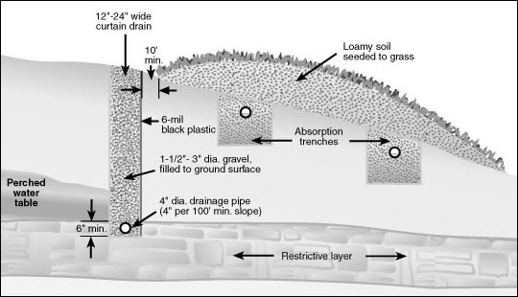
Design and Construction Standards
  Curtain drains (page 38) – must be dug at least 6” into the limiting layer and filled with gravel to the top of the perched water table or 6” above the top limiting layer and covered with barrier material
    Curtain drains shall be daylighted out on at least one end with a screen covering the daylighted end
    Coiled tubing cannot be used
Notes:
2

Slide 69
Design and Construction Standards
(6) Wastewater Stabilization Ponds (page 38)
Construction requirements are based on 440 ft² of surface area at the 3’ operating level
  If a septic tank or aeration unit precedes the pond, a 20% reduction in surface area is allowed, with a minimum of 900 ft² is required at a 3 foot operating level.
Minimum embankment width is 4’
Embankments shall be seeded with hardy local grass and should be mulched
The influent line shall be 4” in diameter, laid at a minimum slope of ¼” per foot
A cleanout shall be provided near the pond embankment
A concrete splash pad shall be placed under the terminus of the pipe
Notes:
2

Slide 70
Design and Construction Standards
(6) Wastewater Stabilization Ponds (page 39)
The wetted area of the pond shall be sealed
  Soil seals must be compacted by the construction equipment or roller
The embankments shall have a 5’ high woven or chain-link fence
  Fence material needs to be present at final
Notes:
2

Slide 71
Design and Construction Standards
(6) Wastewater Stabilization Ponds (page 38)
Heavy timber shall be removed to a distance of 50’ from the pond
Addition of bentonite clay
Landmark | Setback
Property line | 75’ (from shoreline)
Nearest residence | 200’
Residence the pond serves | 100’
Potable water supply | 100’
Stream, water course, lake, or impoundment | 50’
Notes:
2

Slide 72
Design and Construction Standards
(7) Holding Tanks (page 39)
Holding tanks are generally discouraged and shall be approved by CCHD. Use of a holding tank must be specifically approved by the CCHD and will not be approved for a permanent residence except in the case of replacement sites where no other method of treatment is feasible.
Specifications are the same as septic tanks for standard systems
For residences, the tank must be 1000 gallons, or 400 gallons times the number of bedrooms, whichever is greater
For other structures, the tank size is estimated based on flow rates and shall be 5 times the daily flow rate
Holding tanks shall be constructed in an area that is accessible to pump trucks and where accidental spillage will not create a nuisance
A pumping contract is needed and records shall be kept by the homeowner and made available to CCHD upon request
Holding tanks shall be equipped with a high water alarm
Notes:
2

Slide 73
Design and Construction Standards
(8) Alternative Systems (page 40)
Low pressure pipe (LPP)
  The soil scientist specifies the use of LPP
  Must be constructed by an installer specifically licensed for LPPs
Wetlands
  Requires pretreatment (septic tank, aeration unit, lagoon)
  Must be constructed by installer licensed for such systems
Elevated sand mounds
    Utilizes above group soil absorption systems
    Must be constructed by installer licensed for such systems
  Sand filter and pea gravel filter
  Open sand filters will not be permitted
Notes:
2

Slide 74
Design and Construction Standards
Damage repair, replacement and renovation to properly function permitted systems (page 41)
Permitted systems that received a final approval may have these parts of the system repaired or replaced
  Any broken or crushed solid pipe not in the absorption field
  Concrete tanks, drop boxes, distribution boxes, pump tanks
No repair work shall be done on absorption field areas however, the damaged area may be replaced by an equal amount of trench area
If the replacement area is not in the represented soil area, a soil morphology evaluation is needed
When a repair is made to any part of an onsite wastewater system, the tank shall first be pumped and the baffles inspected
Un-permitted systems may not be repaired and must be replaced under current permit.
Notes:
2

Slide 75
Design and Construction Standards
Renovations of systems installed prior to May 1, 1992:
Permitting began in 1992. Systems older than 1992 will not have a permit.
  No repairs are allowed on existing absorption systems that do not have a permit on file, they shall be replaced.
  Septic tanks may not be replaced without bringing the entire system up to current standards.
  An inspection by a site evaluator may be done to determine if system does meet current standards, however this is discouraged
      Will add to the cost if it doesn’t meet current standards
      More often than not, the system will not meet current standards
  If only the lateral needs replaced, and you want to use the current tank, you must lift the tank and put gravel underneath in accordance to the wastewater ordinance and bring tank components up to code.
Notes:
2

Slide 76
Design and Construction Standards
Section VII: Permit revocation or suspension
Reasons:
  Non-compliance with terms of the permit
  Unapproved deviation from application details
  Supplying false information
  Changing site conditions which result in a violation of current standards
Section IX: License revocation or suspension
  First infraction: 30 day suspension
  Second infraction: 90 day suspension
  Third infraction: 1 year revocation
  Fourth infraction: permanent revocation
  *Wastewater class must be retaken and test passed in order to install systems in Christian County.
Notes:
2

Slide 77
Design and Construction Standards
During the time of suspension or revocation no new permits will be issued and no inspections of existing systems will be performed
Penalties of violating the ordinance can include a fine of up to $1,000 and or 1 year in county jail
Appeals can be done through a written statement submitted by at least 30 days from the date of notice of suspension through the health officer and board of appeals. A hearing will be scheduled with a 10 day period to schedule a time to be heard.
Notes:
2

Slide 78
Sizing a System:
In Christian County this can be done by installer, soil scientist, or a professional engineer
(E) Sewage flow rates and calculations (see page 25)
Residential flow rates are determined by the number of bedrooms, and measured in gallons per day (gpd)
  Residential = 120 gpd/bedroom
  The minimum size for an absorption system is 600 square feet.
However, the minimum flow rate for a residential building is 240 gpd even if it is only a one (1) bedroom
*When bedroom occupancy exceeds more than two (2) people per bedroom, an additional 60 gpd/person should be added to the flow rate determined by the number of bedrooms (use only when the number of people occupying each room is known)
Notes:
2

Slide 79
Daily Flow Rate
Given:
3 bedrooms
Find:
The daily flow rate for a system
Refer to page 25 for the Single Family Dwelling
120 gpd x 3 = 360 gpd

Slide 80
Example: How many linear feet are required for a system
Given:
Daily Flow /Loading Rate /Trench Width = Linear Feet required for the system
Given:
  Loading Rate = 0.4 gpd/ft²
  3 bedroom house
  You are using a 3 ft trench width
Find:
Linear feet needed to build the system
  3 bedrooms x 120 gpd (from page 25) = 360 gpd, the total daily flow rate
  360 gpd /0.4 gpd/ft² = 900 ft²
  900 ft² / 3 ft wide trench =
  300 feet is the minimum linear feet of lateral lines required

Slide 81
Loading Rates
Fun with loading rates:
Given:
4 bedrooms
3 ft trench width
See how the minimum lateral required will change with the loading rates:
What is the lateral required for a 0.3 loading rate?
What is the lateral required for a 0.4 loading rate?
What is the lateral required for a 0.5 loading rate?
What is the lateral required for a 0.6 loading rate?
480/ loading rate/ 3 = minimum linear feet of lateral
What happens to the amount of lateral you need to install?

Slide 82
Sizing a System
Flow rates for establishments other than residential dwellings
See Pages 25-27
Commercial Facilities:
Given:
***You Need to add 25 gpd per 8 hour shift employee
A bar with tap (that has no food prep) and has 20 seats, and two 8 hour employees.
Find:
What is the daily flow rate?
Notes:
2

Slide 83
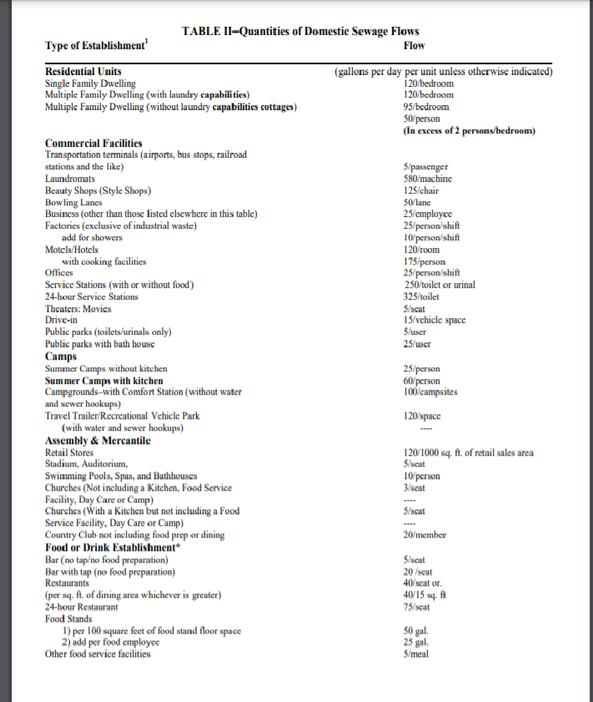
Table II Quantities of Domestic Sewage Flows Pg 25

Slide 84
Sizing a System
You were Given:
20 seats x 20 gpd (from page 25)= 400 gpd…This is for seats
AND
2-eight hour employees x 25 gpd per employee =
50 gpd…This is for employees
Add them up to get the total flow:
400+50= 450 gpd
Daily flow rate = 450 gpd
Notes:
2

Slide 85
Sizing a System
What size tank do you need to use?
Tank size equation:
Volume of tank = 1.5Q + 500
Notes:
2

Slide 86
Sizing a System
You already calculated:
20 seats x 20 gpd (from page 25)= 400 gpd
2-eight hour employees x 25gpd = 50 gpd
Daily flow rate = 450 gpd the daily flow rate
Now you need to know that the daily flow rate is called “Q”
What size tank to use?
Tank size equation: Volume = 1.5Q + 500
Tank Volume = 1.5(450 gpd) + 500 = 1,175 gallons
Notes:
2

Slide 87
Sizing a System
How many feet of lateral is needed? (given a 0.4gpd/ft² load rate)
You calculated this already:
20 seats x 20gpd (from page 25)= 400 gpd
2-eight hour employees x 25gpd = 50 gpd
Total flow rate = 450 gpd
Flow Rate ÷ Load Rate ÷ Trench Width(ft) = Min Laterals ft
450 gpd ÷ 0.4 gpd/ft² = 1,125 ft² trench bottom required
1,125 ft² ÷ 3 ft wide bucket = 375 minimum linear ft laterals
Notes:
2

